Slide 1
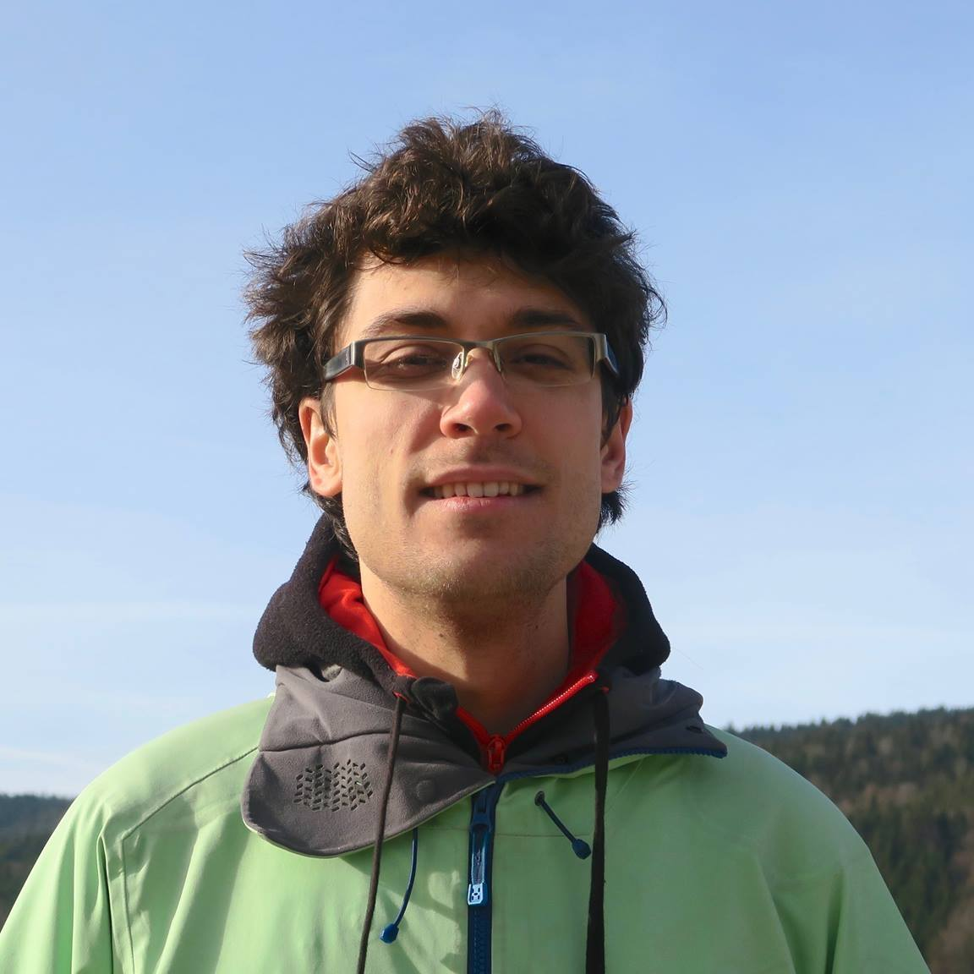




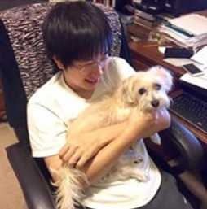

Fast and Space-Optimal Streaming Algorithms for Euclidean Clustering
Vincent Cohen-Addad
Liudeng Wang
David P. Woodruff
Samson Zhou

Slide 2
Goal: Quickly cluster a stream of $n$ points using $O(1)$ space

Slide 3
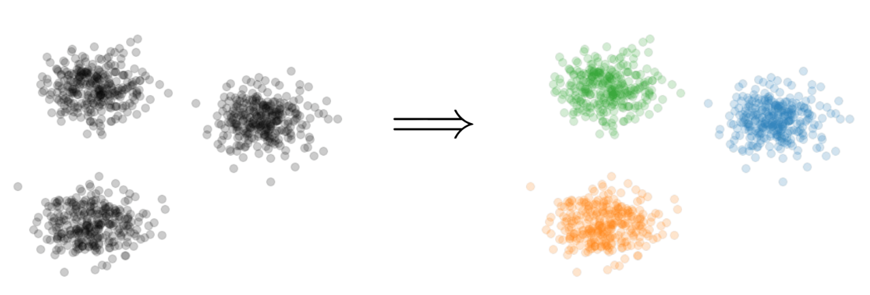

$k$-Clustering
Goal: Given input dataset $X$, find a set $C$ of $k$ centers that implicitly partition $X$ into at most $k$different clusters, while minimizing some associated cost function of the clustering
$$k=3$$

Slide 4
$k$-Clustering
Define clustering cost $Cost\left(X,C\right)$ to be a function of ${\left\{dist\left(x,C\right)\right\}}_{x∈X}$
$k$-median: $Cost\left(X,C\right)=\sum_{x∈X}{dist\left(x,C\right)}$
$k$-means: $Cost\left(X,C\right)=\sum_{x∈X}{{\left(dist\left(x,C\right)\right)}^{2}}$
$(k,z)$-clustering: $Cost\left(X,C\right)=\sum_{x∈X}{{\left(dist\left(x,C\right)\right)}^{z}}$
$${\left(⋅\right)}^{z}$$
$${\left(⋅\right)}^{z}$$
$${\left(⋅\right)}^{z}$$
$${\left(⋅\right)}^{z}$$
$${\left(⋅\right)}^{z}$$
$${\left(⋅\right)}^{z}$$
$${\left(⋅\right)}^{z}$$

Slide 5
Euclidean $k$-Clustering
For Euclidean $k$-clustering, input points $X=x_{1},…,x_{n}$ are in $ℝ^{d}$ (for us, they will be in ${[Δ]}^{d}≔{\left\{1,2,…,Δ\right\}}^{d}$)
$dist\left(x,y\right)=\sqrt{{\left(x_{1}−y_{1}\right)}^{2}+…+{\left(x_{d}−y_{d}\right)}^{2}}$ is the Euclidean distance
$(k,z)$-clustering problem:
$$\min_{C:\left|C\right|≤k} Cost\left(X,C\right)=\min_{C:\left|C\right|≤k}{Σ_{x∈X}\left(dist\left(x,C\right)\right)}^{z}$$

Slide 6

A Streaming Model
Input: Underlying data set $X$ arrives sequentially
Output: Output a “good” set $C_{t}$ of $k$ centers at each time $t$
Goal: Use space sublinear in the size $n$of the input $X$, with fast update time

Slide 7
Coreset
Weighted ($w$) subset $X′$ of representative points of $X$ for a specific clustering objective
For all sets $C$ with $\left|C\right|=k$,
$$\left(1−ε\right)Cost(X,C)≤Cost(X′,C,w)≤\left(1+ε\right)Cost(X,C)$$

Slide 8
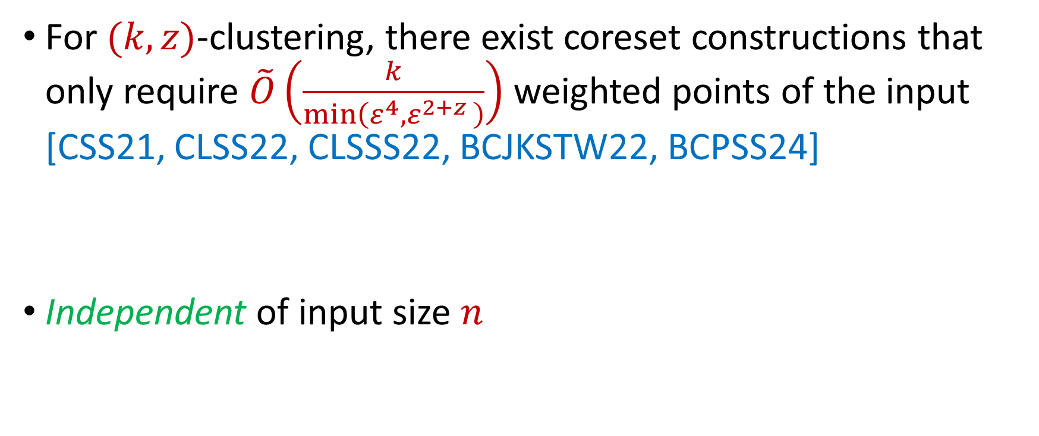
Coreset Constructions
For $(k,z)$-clustering, there exist coreset constructions that only require $\tilde{O}\left(\frac{k}{\min\left(ε^{4},ε^{2+z }\right)}\right)$ weighted points of the input [CSS21, CLSS22, CLSSS22, BCJKSTW22, BCPSS24]
Independent of input size $n$

Slide 9

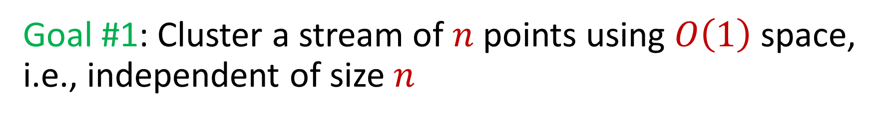
Goal #1: Cluster a stream of $n$ points using $O\left(1\right)$ space, i.e., independent of size $n$
Goal #2: Cluster a stream of $n$ points using $o\left(k\right)$ amortized update time

Slide 10
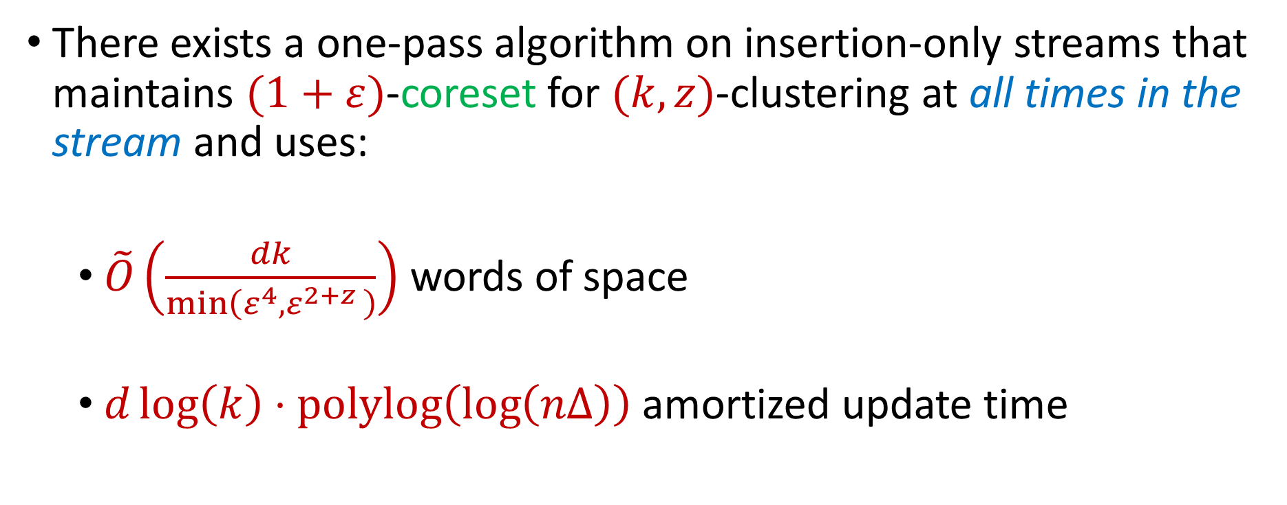
Our Results (I)
There exists a one-pass algorithm on insertion-only streams that maintains $(1+ε)$-coreset for $(k,z)$-clustering at all times in the stream and uses:
$\tilde{O}\left(\frac{dk}{\min\left(ε^{4},ε^{2+z }\right)}\right)$ words of space
$d\log\left(k\right)⋅polylog\left(\log\left(nΔ\right)\right)$ amortized update time

Slide 11
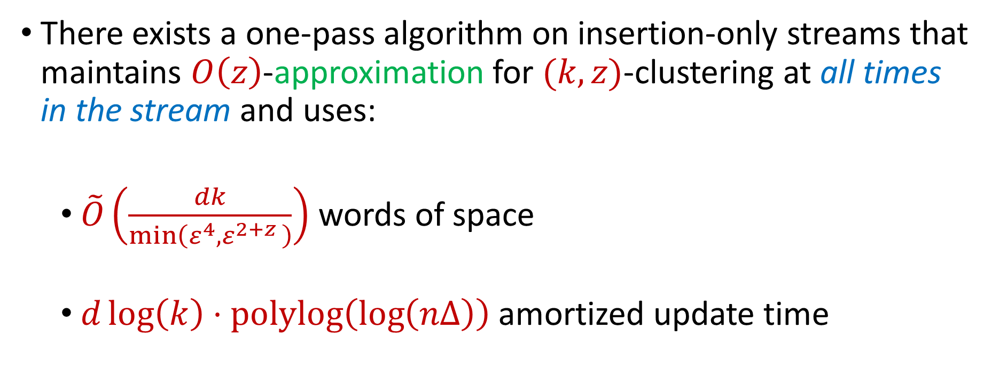
Corollary
There exists a one-pass algorithm on insertion-only streams that maintains $O\left(z\right)$-approximation for $(k,z)$-clustering at all times in the stream and uses:
$\tilde{O}\left(\frac{dk}{\min\left(ε^{4},ε^{2+z }\right)}\right)$ words of space
$d\log\left(k\right)⋅polylog\left(\log\left(nΔ\right)\right)$ amortized update time

Slide 12
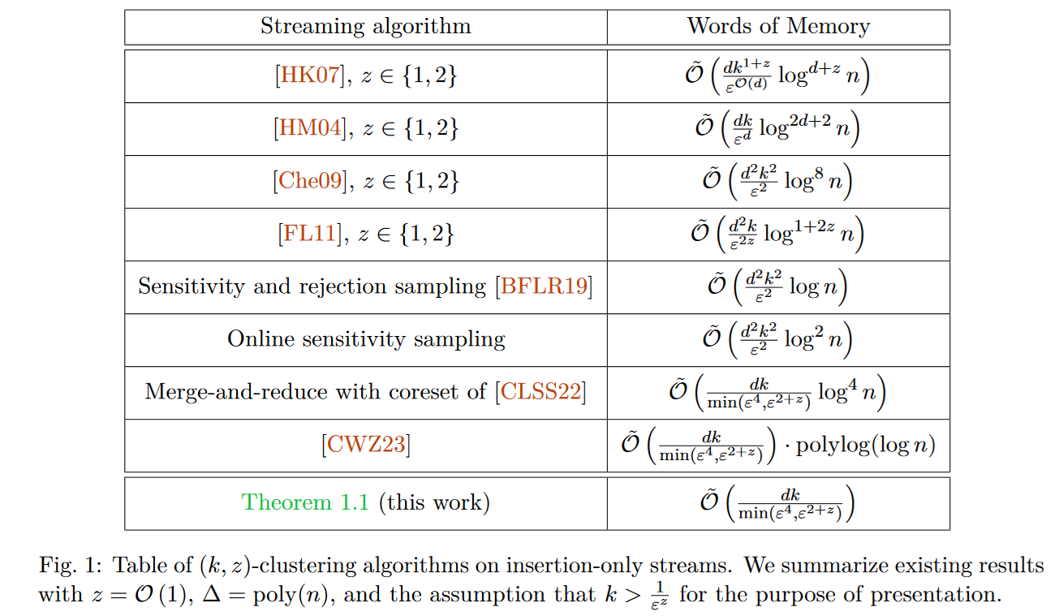

Slide 13
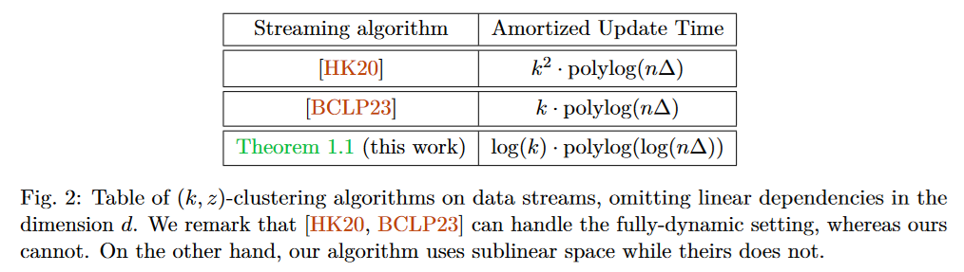

Slide 14
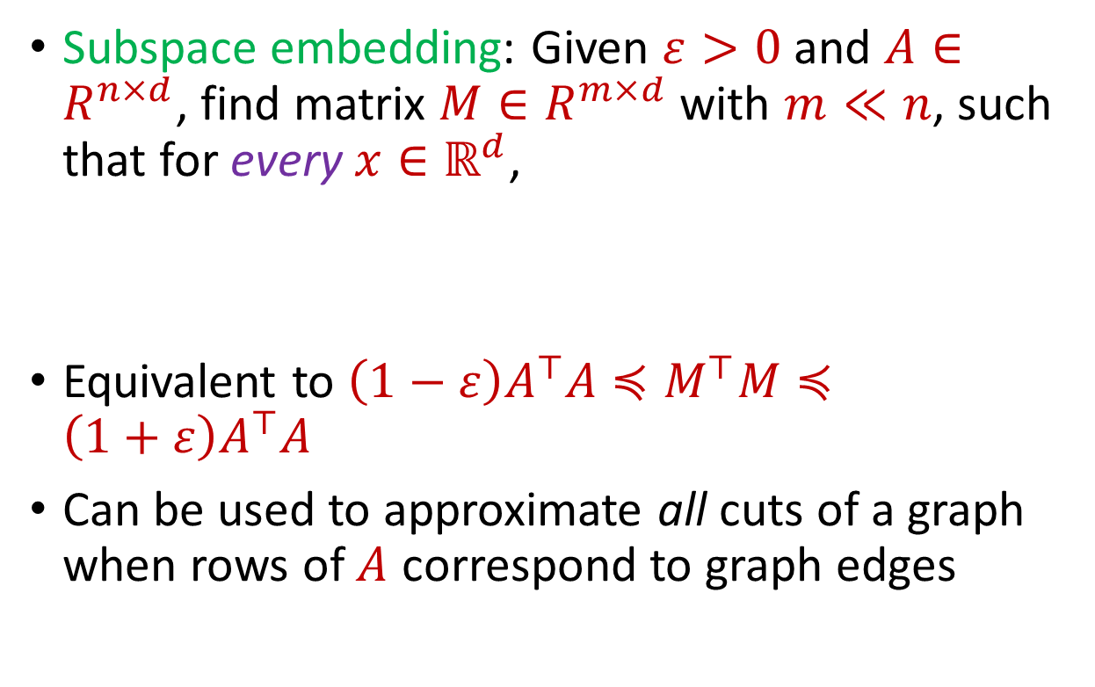


Subspace Embedding
Subspace embedding: Given $ε>0$ and $A∈R^{n×d}$, find matrix $M∈R^{m×d}$ with $m≪n$, such that for every $x∈ℝ^{d}$,
Equivalent to $\left(1−ε\right)A^{⊤}A≼M^{⊤}M≼\left(1+ε\right)A^{⊤}A$
Can be used to approximate all cuts of a graph when rows of $A$ correspond to graph edges
$$A$$
$$x$$
$$n$$
$$\left(1−ε\right){\left\|Ax\right\|}_{2}≤{\left\|Mx\right\|}_{2}≤\left(1+ε\right){\left\|Ax\right\|}_{2}$$
$$d$$

Slide 15
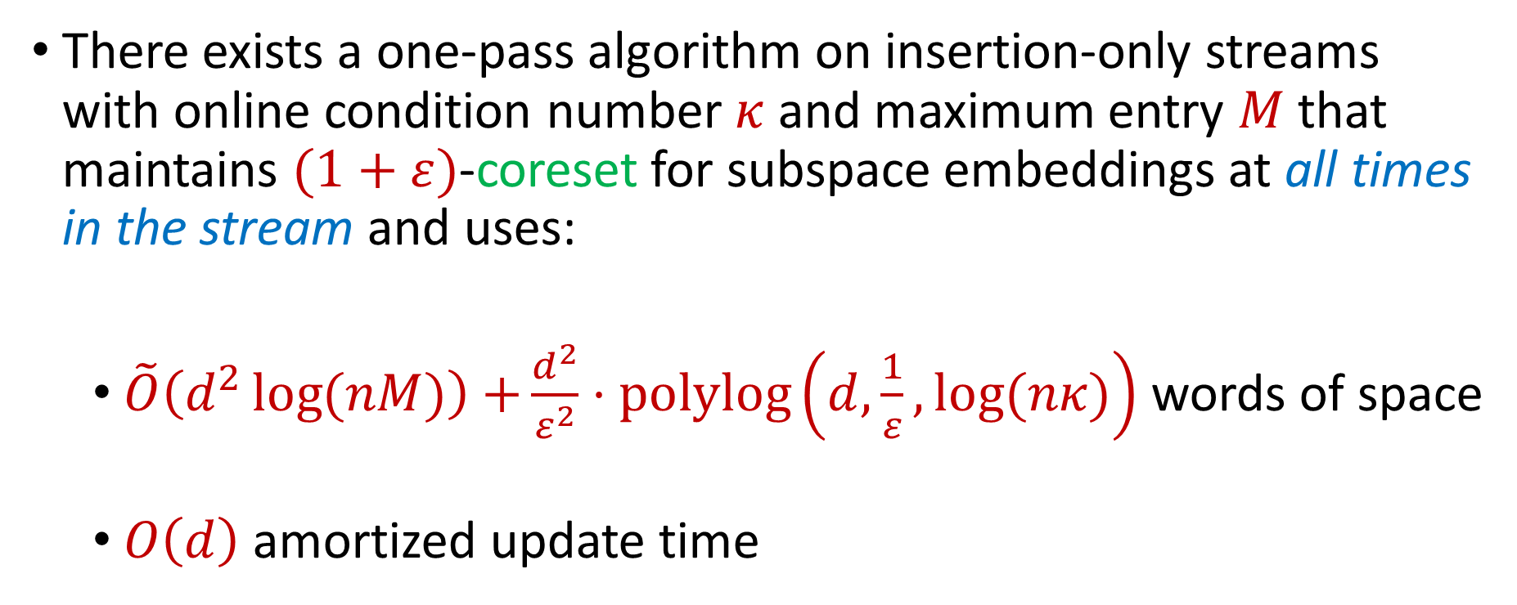
Our Results (II)
There exists a one-pass algorithm on insertion-only streams with online condition number $κ$and maximum entry $M$that maintains $(1+ε)$-coreset for subspace embeddings at all times in the stream and uses:
$\tilde{O}\left(d^{2}\log{(nM)}\right)$ $+\frac{d^{2}}{ε^{2}}⋅polylog\left(d, \frac{1}{ε},\log{(nκ)}\right)$ words of space
$O\left(d\right)$ amortized update time

Slide 16
Our Results (III)
Structural properties in “efficient encoding” also give improved communication bounds for clustering in distributed models

Slide 17


Questions?
Upcoming
$(k,z)$-Clustering in $O(1)$ Space

Slide 18
Goal #1: Cluster a stream of $n$ points using $O\left(1\right)$ space, i.e., independent of size $n$
Goal #2: Cluster a stream of $n$ points using $o\left(k\right)$ amortized update time

Slide 19

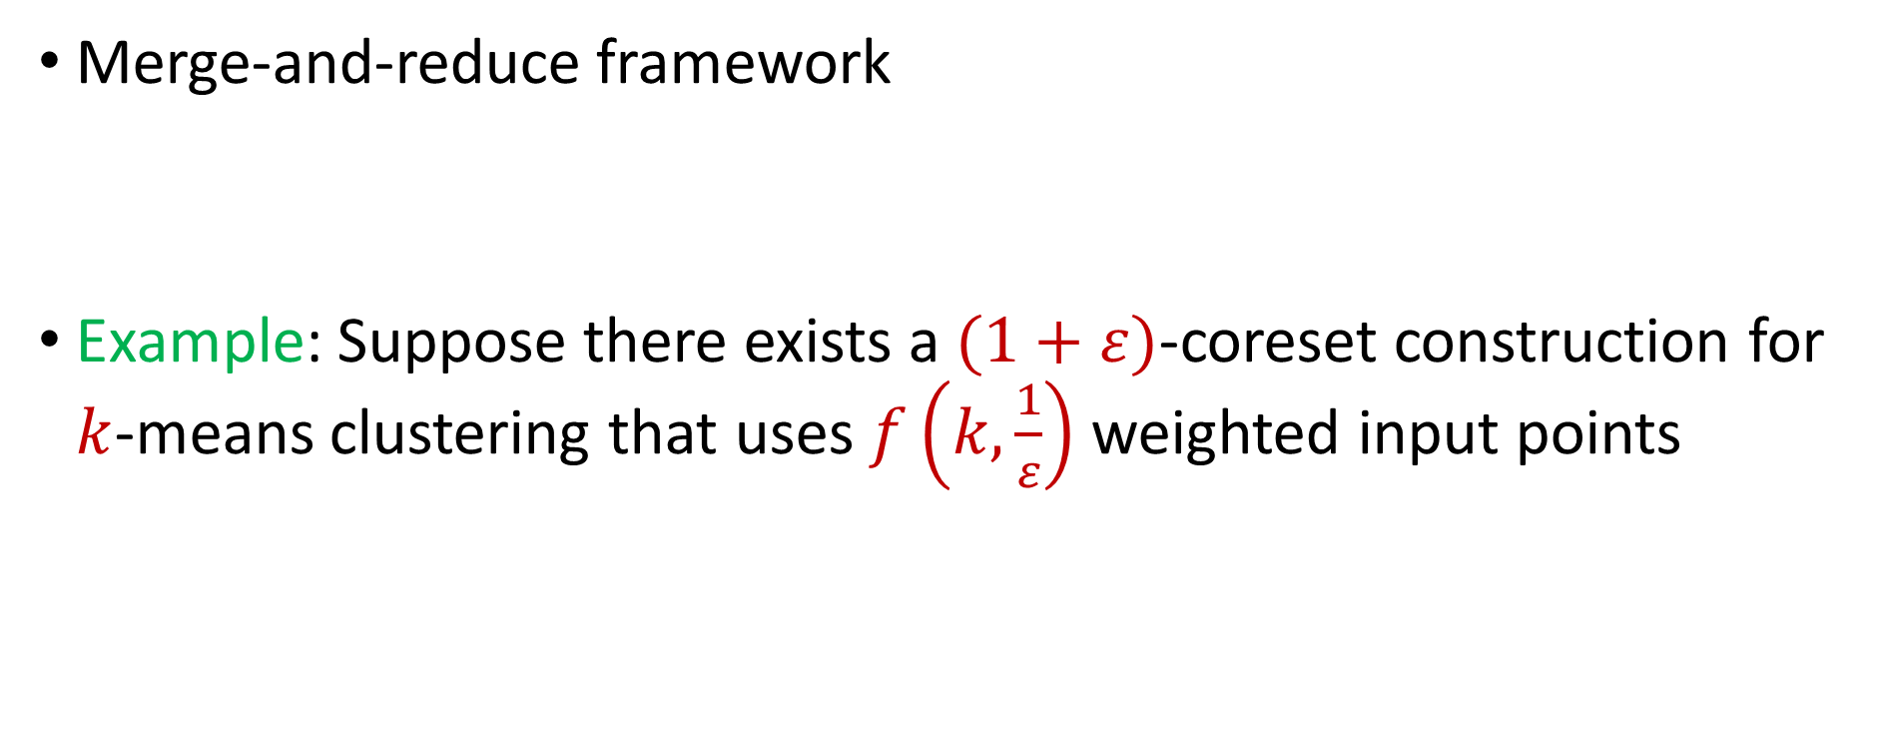
$(k,z)$-Clustering in the Streaming Model
Merge-and-reduce framework
Example: Suppose there exists a $(1+ε)$-coreset construction for $k$-means clustering that uses $f\left(k,\frac{1}{ε}\right)$ weighted input points
$$\tilde{O}\left(\frac{k}{ε^{4}}\right)$$

Slide 20
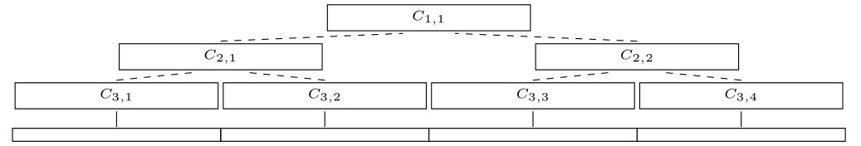

$(k,z)$-Clustering in the Streaming Model
Partition the stream into blocks containing $f\left(k,\frac{\log{n}}{ε}\right)$ points
Create a $\left(1+\frac{ε}{\log{n}}\right)$-coreset for each block
Create a $\left(1+\frac{ε}{\log{n}}\right)$-coreset for the set of points formed by the union of two coresets for each block
$$\tilde{O}\left(\frac{k}{ε^{4}}\log^{2}{n}\right)$$
Merge
Reduce

Slide 21
$(k,z)$-Clustering in the Streaming Model
There are $O\left(log n\right)$ levels
Each coreset is a $\left(1+\frac{ε}{\log{n}}\right)$-coreset of two coresets
Total approximation is ${\left(1+\frac{ε}{\log{n}}\right)}^{\log{n}}=(1+O\left(ε\right))$

Slide 22
$(k,z)$-Clustering in the Streaming Model
Total space is $f\left(k,\frac{\log{n}}{ε}\right)⋅O(log{n)}$ points
For $k$-means clustering, this is $\tilde{O}\left(\frac{k}{ε^{4}}⋅\log^{3}{n}\right)$ points
Not independent of size $n$ of the stream length!

Slide 23

Sensitivity Sampling
The quantity $s\left(x\right)=\max_{C}\frac{Cost\left(x,C\right)}{Cost\left(X,C\right)}$ is called the sensitivity of $x$ and intuitively measures how “important” the point $x$ is

Slide 24
Online Sensitivity Sampling
In a data stream, computing/approximating sensitivity $s\left(x\right)=\max_{C}\frac{Cost\left(x,C\right)}{Cost\left(X,C\right)}$ requires seeing the entire dataset $X$, but then it is too late to sample $x$
We define the online sensitivity of $x_{t}$ with respect to a stream $x_{1},…,x_{n}$ to be $φ\left(x_{t}\right)=\max_{C}\frac{Cost\left(x_{t},C\right)}{Cost\left(X_{t},C\right)}$, where $X_{t}=x_{1},…,x_{t}$, which intuitively measures how “important” the point $x$ is SO FAR

Slide 25
Online Sensitivity Sampling
Observation: we can use a $\left(1+ε\right)$-coreset to obtain a $\left(1+ε\right)$-approximation to $φ\left(x_{t}\right)$
Use samples obtained from online sensitivity sampling at each time $t−1$ to obtain a $\left(1+ε\right)$-approximation to $φ\left(x_{t}\right)$
Can then perform online sensitivity sampling at time $t$ and by induction, at all times in the stream

Slide 26
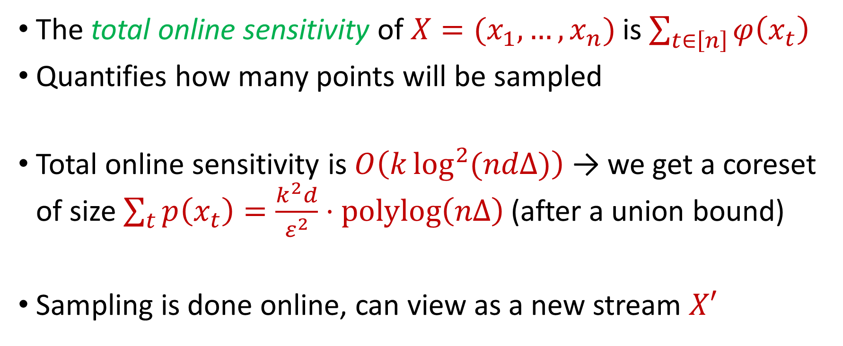
Online Sensitivity Sampling
The total online sensitivity of $X=(x_{1},…,x_{n})$ is $\sum_{t∈\left[n\right]}{φ\left(x_{t}\right)}$
Quantifies how many points will be sampled
Total online sensitivity is $O\left(k\log^{2}{(ndΔ)}\right)$ → we get a coreset of size $\sum_{t}{p\left(x_{t}\right)}=\frac{k^{2}d}{ε^{2}}⋅polylog\left(nΔ\right)$ (after a union bound)
Sampling is done online, can view as a new stream $X′$

Slide 27
Insertion-Only Algorithm [CWZ23]
Perform online sensitivity sampling to implicitly create new stream $X′$
In parallel, run merge-and-reduce on $X^{′}$

Slide 28
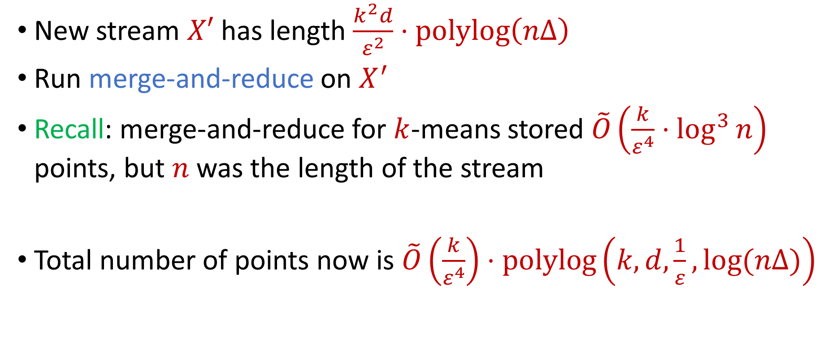
Insertion-Only Algorithm [CWZ23]
New stream $X′$ has length $\frac{k^{2}d}{ε^{2}}⋅polylog\left(nΔ\right)$
Run merge-and-reduce on $X^{′}$
Recall: merge-and-reduce for $k$-means stored $\tilde{O}\left(\frac{k}{ε^{4}}⋅\log^{3}{n}\right)$ points, but $n$ was the length of the stream
Total number of points now is $\tilde{O}\left(\frac{k}{ε^{4}}\right)⋅polylog\left(k,d,\frac{1}{ε},log⁡(nΔ)\right)$

Slide 29
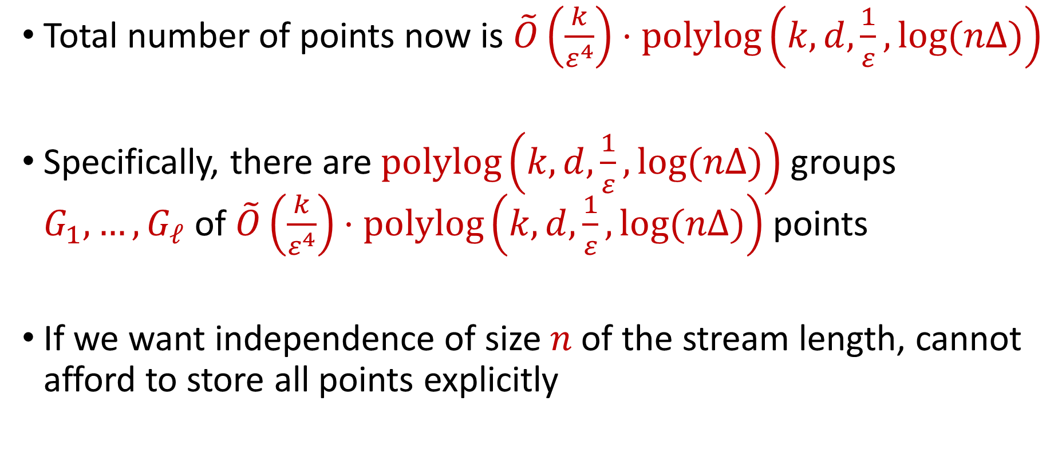
Insertion-Only Algorithm
Total number of points now is $\tilde{O}\left(\frac{k}{ε^{4}}\right)⋅polylog\left(k,d,\frac{1}{ε},log⁡(nΔ)\right)$
Specifically, there are $polylog\left(k,d,\frac{1}{ε},log⁡(nΔ)\right)$ groups $G_{1},…, G_{ℓ}$ of $\tilde{O}\left(\frac{k}{ε^{4}}\right)⋅polylog\left(k,d,\frac{1}{ε},log⁡(nΔ)\right)$ points
If we want independence of size $n$ of the stream length, cannot afford to store all points explicitly

Slide 30


$$G_{1},…,G_{ℓ}$$
$$X′$$
Online sensitivity sampling
$$X$$
Stream

Slide 31
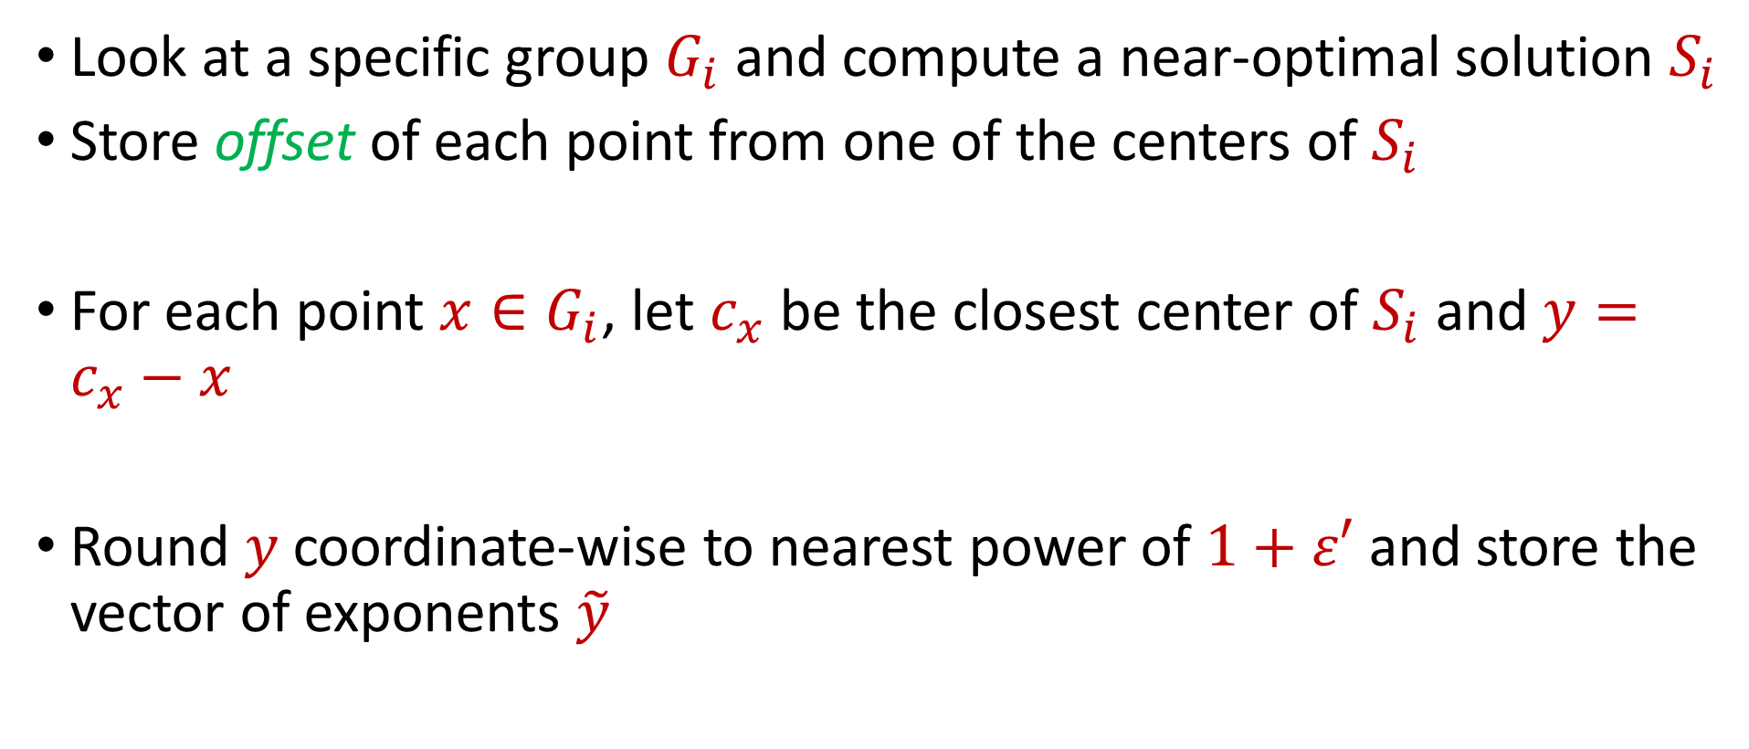
Efficient Local Encoding
Look at a specific group $G_{i}$ and compute a near-optimal solution $S_{i}$
Store offset of each point from one of the centers of $S_{i}$
For each point $x∈G_{i}$, let $c_{x}$ be the closest center of $S_{i}$ and $y=c_{x}−x$
Round $y$ coordinate-wise to nearest power of $1+ε′$ and store the vector of exponents $\tilde{y}$

Slide 32
Efficient Local Encoding
$$x$$
$$c_{x}$$

Slide 33
Efficient Local Encoding
$$x$$
$$y=c_{x}−x$$
$$c_{x}$$

Slide 34
Efficient Local Encoding
$$x$$
$$\tilde{y}$$
$$c_{x}$$

Slide 35
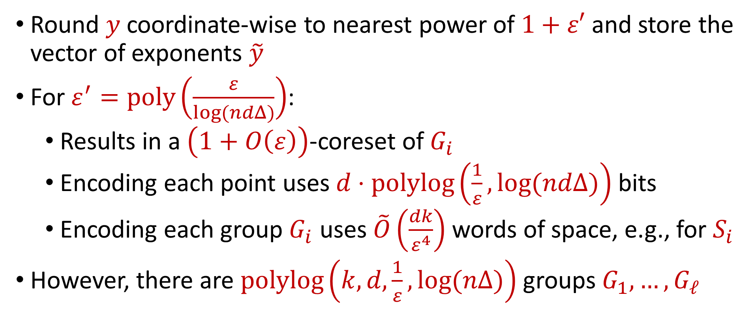
Efficient Local Encoding
Round $y$ coordinate-wise to nearest power of $1+ε′$ and store the vector of exponents $\tilde{y}$
For $ε^{′}=poly\left(\frac{ε}{log(ndΔ)}\right)$:
Results in a $\left(1+O\left(ε\right)\right)$-coreset of $G_{i}$
Encoding each point uses $d⋅$ $polylog\left(\frac{1}{ε},log⁡(ndΔ)\right)$ bits
Encoding each group $G_{i}$ uses $\tilde{O}\left(\frac{dk}{ε^{4}}\right)$words of space, e.g., for $S_{i}$
However, there are $polylog\left(k,d,\frac{1}{ε},log⁡(nΔ)\right)$ groups $G_{1},…, G_{ℓ}$

Slide 36


$$S_{1},…,S_{ℓ}$$
Encoding
$$G_{1},…,G_{ℓ}$$
$$X′$$
Online sensitivity sampling
$$X$$
Stream

Slide 37
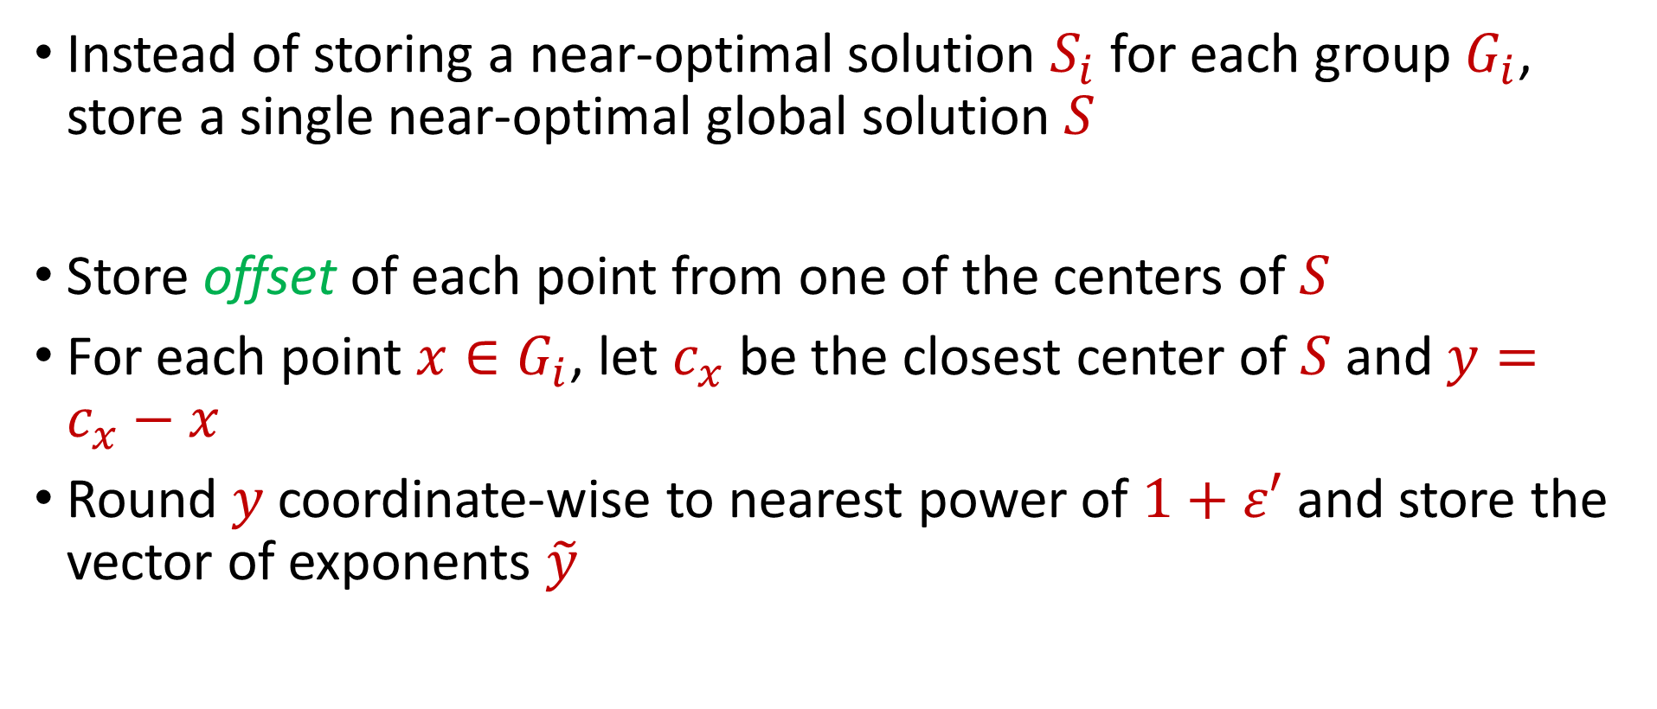
Global Encoding
Instead of storing a near-optimal solution $S_{i}$for each group $G_{i}$, store a single near-optimal global solution $S$
Store offset of each point from one of the centers of $S$
For each point $x∈G_{i}$, let $c_{x}$ be the closest center of $S$ and $y=c_{x}−x$
Round $y$ coordinate-wise to nearest power of $1+ε′$ and store the vector of exponents $\tilde{y}$

Slide 38
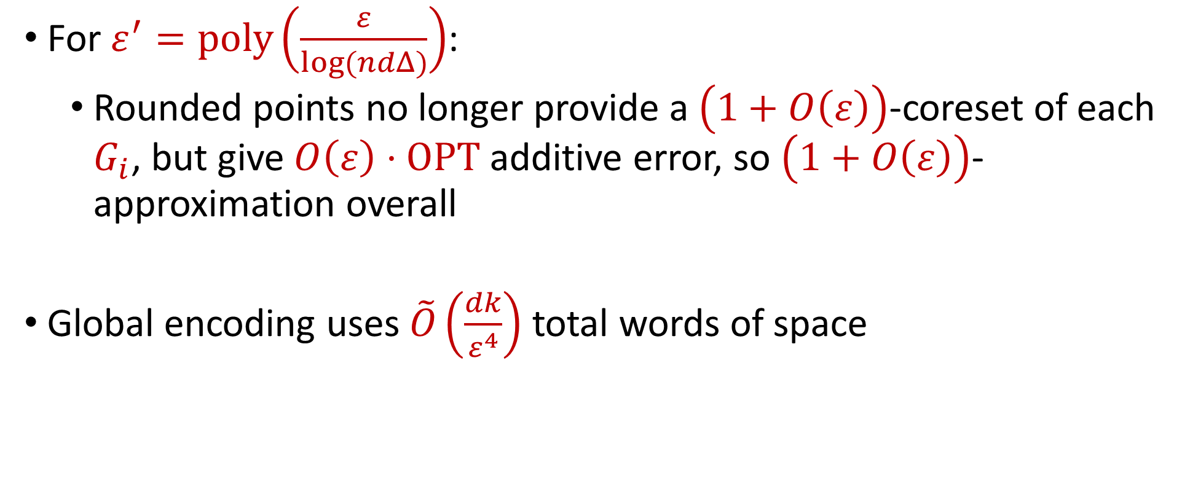
Global Encoding
For $ε^{′}=poly\left(\frac{ε}{log(ndΔ)}\right)$:
Rounded points no longer provide a $\left(1+O\left(ε\right)\right)$-coreset of each $G_{i}$, but give $O\left(ε\right)⋅OPT$ additive error, so $\left(1+O\left(ε\right)\right)$-approximation overall
Global encoding uses $\tilde{O}\left(\frac{dk}{ε^{4}}\right)$total words of space

Slide 39
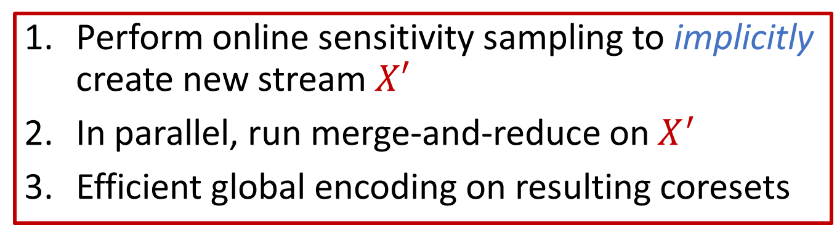


$$S$$
Global Encoding
$$G_{1},…,G_{ℓ}$$
$$X′$$
Online sensitivity sampling
Stream
$$X$$
Perform online sensitivity sampling to implicitly create new stream $X′$
In parallel, run merge-and-reduce on $X^{′}$
Efficient global encoding on resulting coresets

Slide 40

Questions?
Upcoming
$(k,z)$-Clustering in $o(k)$ Amortized Update Time

Slide 41
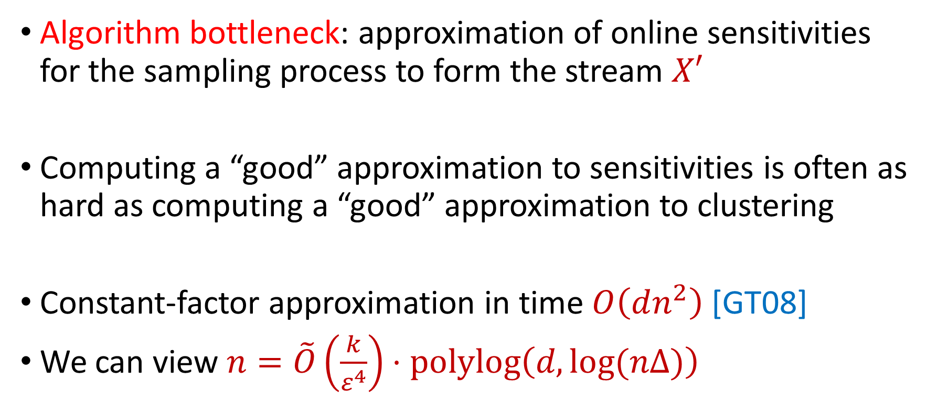
Fast Clustering
Algorithm bottleneck: approximation of online sensitivities for the sampling process to form the stream $X′$
Computing a “good” approximation to sensitivities is often as hard as computing a “good” approximation to clustering
Constant-factor approximation in time $O\left(dn^{2}\right)$ [GT08]
We can view $n=\tilde{O}\left(\frac{k}{ε^{4}}\right)⋅polylog\left(d, log⁡(nΔ)\right)$

Slide 42
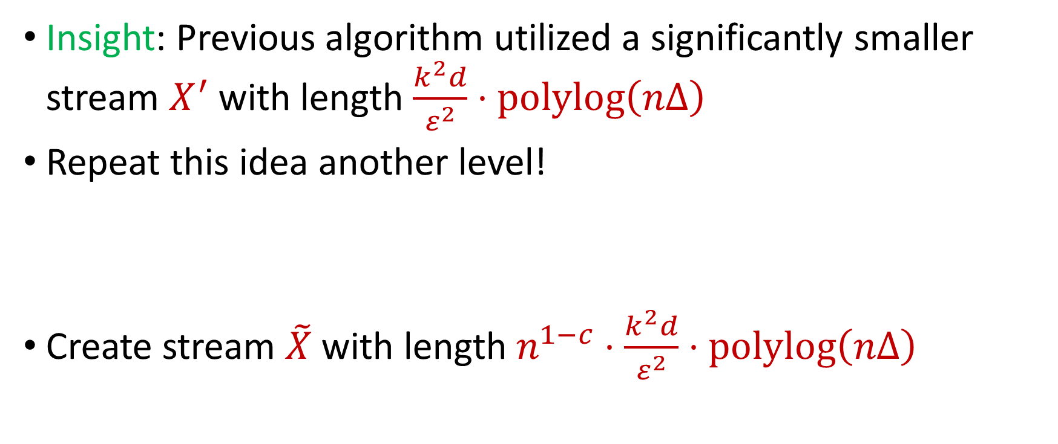
Fast Clustering
Insight: Previous algorithm utilized a significantly smaller stream $X^{′}$ with length $\frac{k^{2}d}{ε^{2}}⋅polylog\left(nΔ\right)$
Repeat this idea another level!
Create stream $\tilde{X}$with length $n^{1−c}⋅\frac{k^{2}d}{ε^{2}}⋅polylog\left(nΔ\right)$

Slide 43
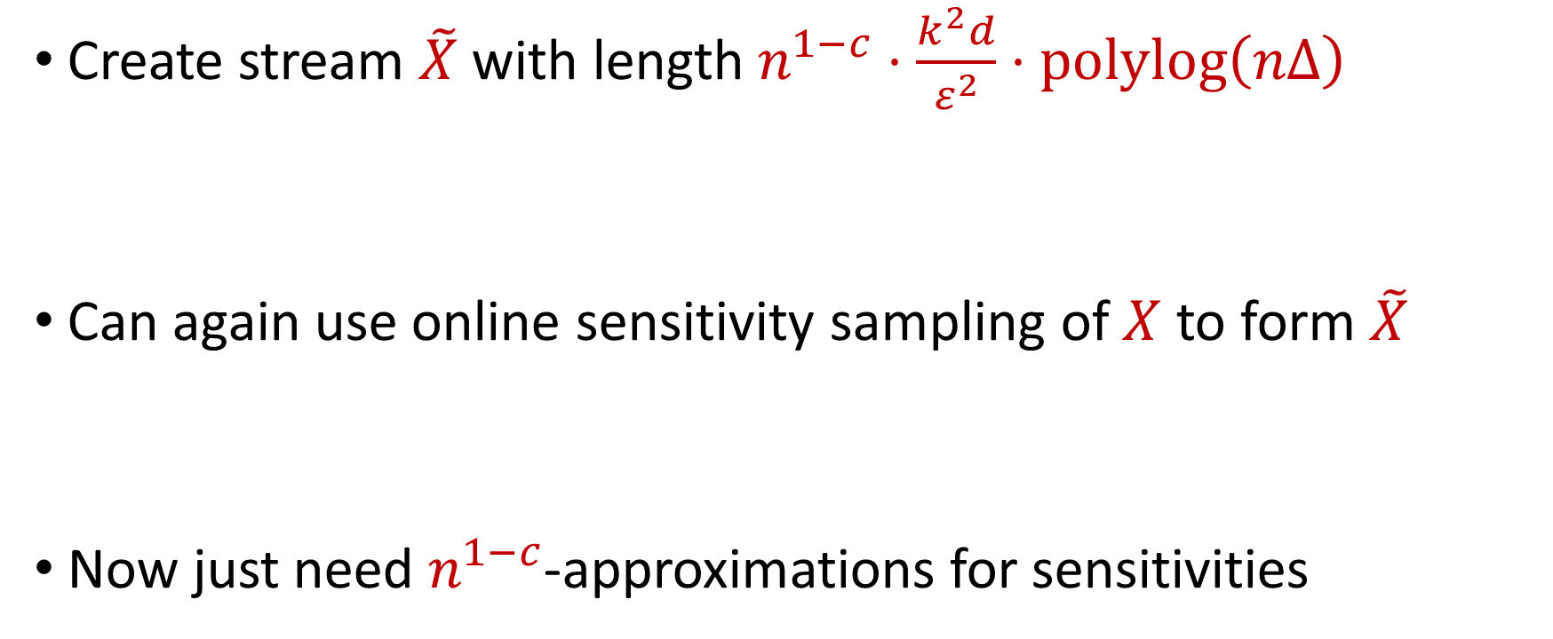
Fast Clustering
Create stream $\tilde{X}$with length $n^{1−c}⋅\frac{k^{2}d}{ε^{2}}⋅polylog\left(nΔ\right)$
Can again use online sensitivity sampling of $X$ to form $\tilde{X}$
Now just need $n^{1−c}$-approximations for sensitivities

Slide 44

Fast Clustering
Theorem: For any constant $c∈(0,1)$, there exists an algorithm that computes $n^{1−c}$-approximations to the sensitivities of a batch of $k$ points of $X$ using $d\log\left(k\right)⋅polylog\left(\log\left(nΔ\right)\right)$ amortized update time

Slide 45
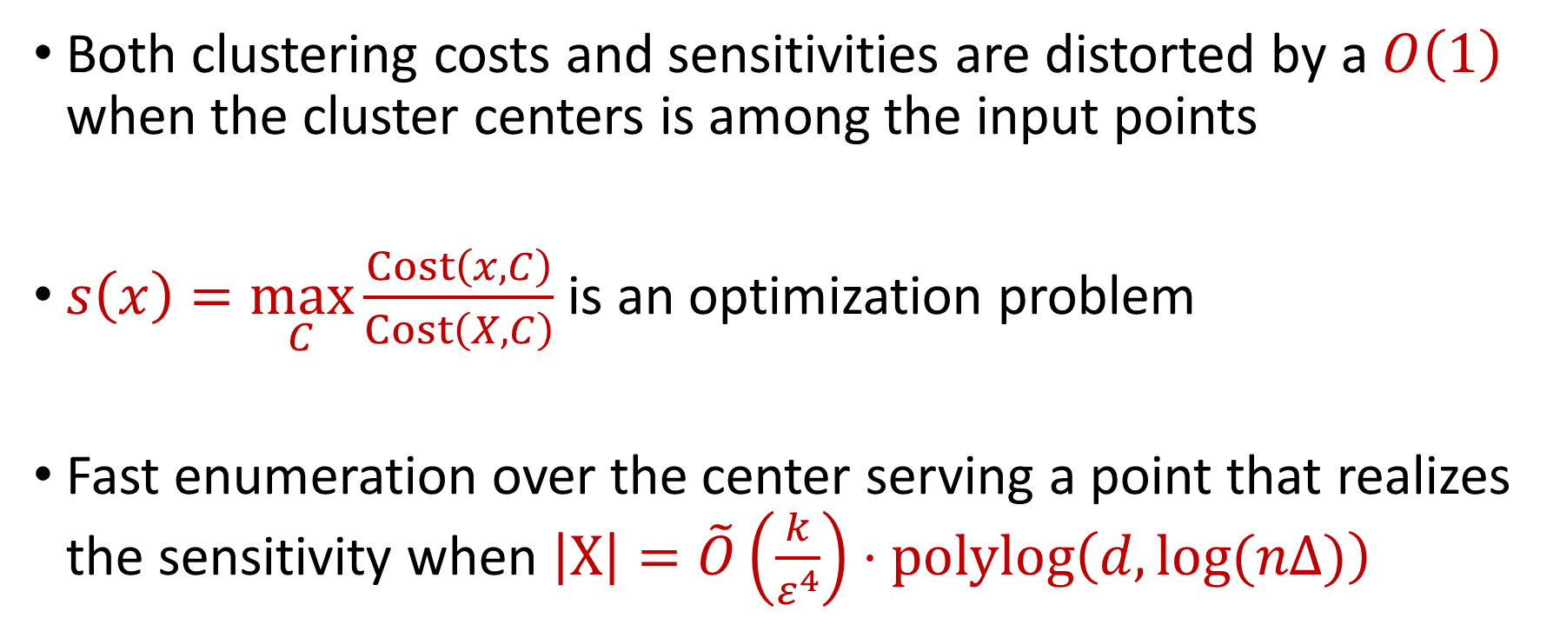
Structural Property
Both clustering costs and sensitivities are distorted by a $O\left(1\right)$ when the cluster centers is among the input points
$s\left(x\right)=\max_{C}\frac{Cost\left(x,C\right)}{Cost\left(X,C\right)}$ is an optimization problem
Fast enumeration over the center serving a point that realizes the sensitivity when $\left|X\right|=\tilde{O}\left(\frac{k}{ε^{4}}\right)⋅polylog\left(d, log⁡(nΔ)\right)$

Slide 46
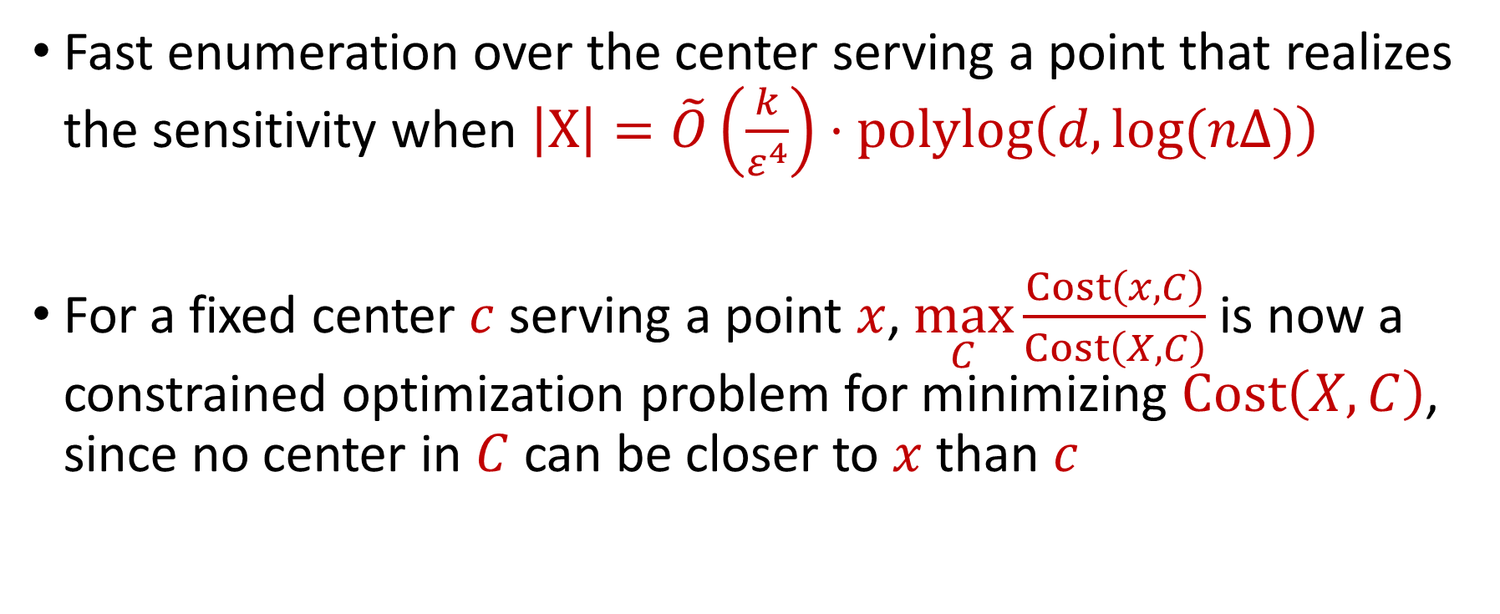
Structural Property
Fast enumeration over the center serving a point that realizes the sensitivity when $\left|X\right|=\tilde{O}\left(\frac{k}{ε^{4}}\right)⋅polylog\left(d, log⁡(nΔ)\right)$
For a fixed center $c$ serving a point $x$, $\max_{C}\frac{Cost\left(x,C\right)}{Cost\left(X,C\right)}$ is now a constrained optimization problem for minimizing $Cost\left(X,C\right)$, since no center in $C$ can be closer to $x$ than $c$

Slide 47

Quadtree Embedding
$$Δ$$

Slide 48
Quadtree Embedding
$$Δ$$

Slide 49
Quadtree Embedding
$$Δ$$

Slide 50
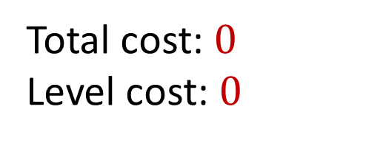
Quadtree Embedding
Total cost: $0$
Level cost: $0$
7
$$Δ$$
6
6

Slide 51
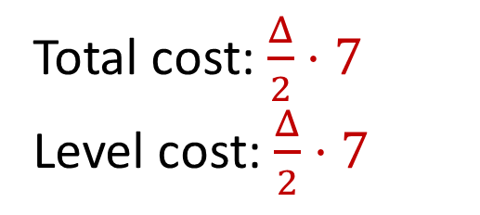
Quadtree Embedding
Total cost: $\frac{Δ}{2}⋅7$
Level cost: $\frac{Δ}{2}⋅7$
7
$$Δ$$
6
6

Slide 52
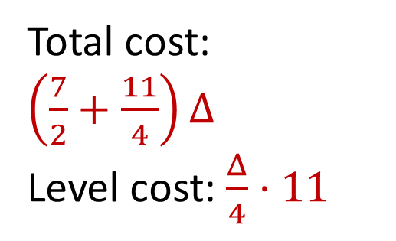
Quadtree Embedding
Total cost: $\left(\frac{7}{2}+\frac{11}{4}\right)Δ$
Level cost: $\frac{Δ}{4}⋅11$
7
$$Δ$$
6
6

Slide 53
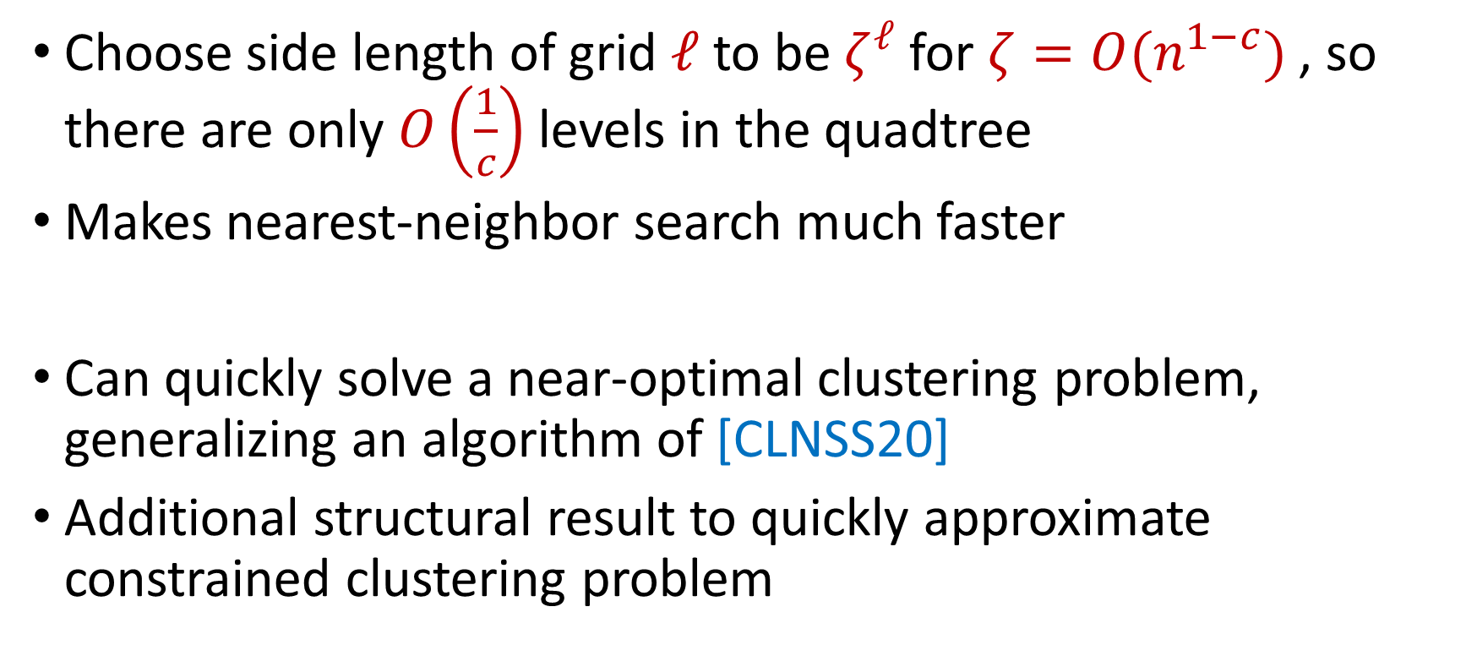
Fast Clustering
Choose side length of grid $ℓ$ to be $ζ^{ℓ}$ for $ζ=O(n^{1−c})$ , so there are only $O\left(\frac{1}{c}\right)$ levels in the quadtree
Makes nearest-neighbor search much faster
Can quickly solve a near-optimal clustering problem, generalizing an algorithm of [CLNSS20]
Additional structural result to quickly approximate constrained clustering problem

Slide 54
Constrained Clustering
7
6
6

Slide 55
Constrained Clustering
7
6
6

Slide 56
Constrained Clustering
7
6
6

Slide 57
Questions?
Upcoming
Subspace embeddings

Slide 58
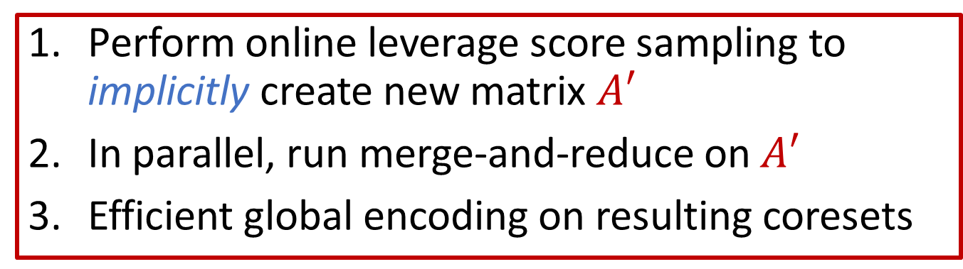
Perform online leverage score sampling to implicitly create new matrix $A′$
In parallel, run merge-and-reduce on $A′$
Efficient global encoding on resulting coresets

Slide 59
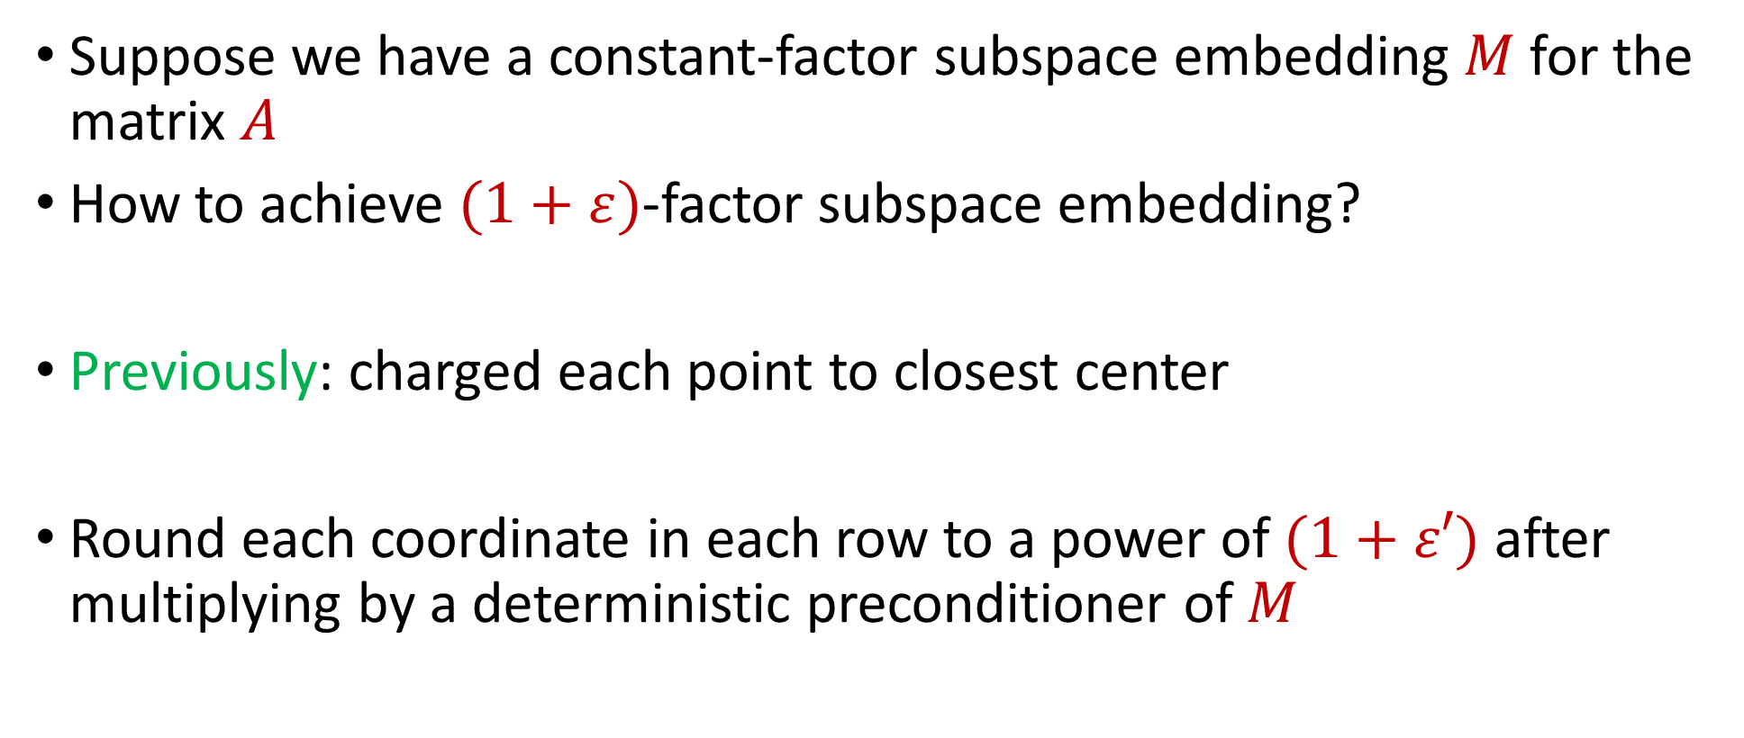
Efficient Local Encoding
Suppose we have a constant-factor subspace embedding $M$ for the matrix $A$
How to achieve $(1+ε)$-factor subspace embedding?
Previously: charged each point to closest center
Round each coordinate in each row to a power of $(1+ε′)$ after multiplying by a deterministic preconditioner of $M$

Slide 60
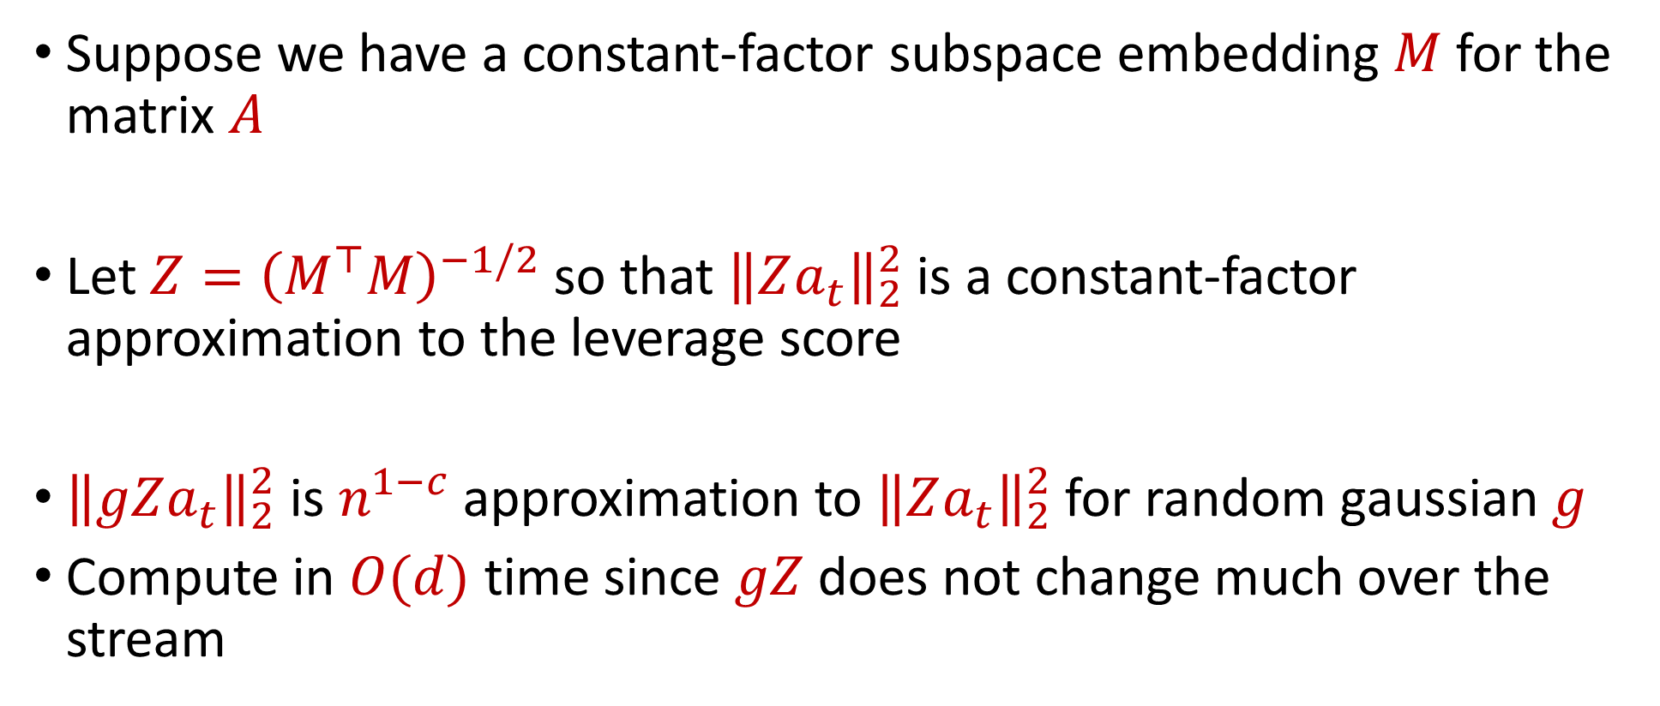
Crude Leverage Score Approximation
Suppose we have a constant-factor subspace embedding $M$ for the matrix $A$
Let $Z={\left(M^{⊤}M\right)}^{−1/2}$ so that ${\left\|Za_{t}\right\|}_{2}^{2}$ is a constant-factor approximation to the leverage score
${\left\|gZa_{t}\right\|}_{2}^{2}$ is $n^{1−c}$ approximation to ${\left\|Za_{t}\right\|}_{2}^{2}$ for random gaussian $g$
Compute in $O(d)$ time since $gZ$ does not change much over the stream

Slide 61
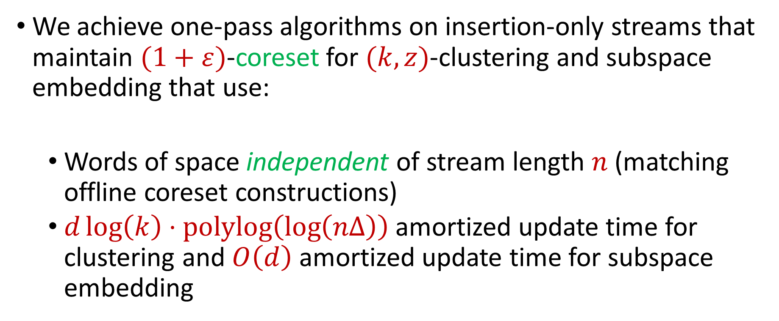
Summary
We achieve one-pass algorithms on insertion-only streams that maintain $(1+ε)$-coreset for $(k,z)$-clustering and subspace embedding that use:
Words of space independent of stream length $n$ (matching offline coreset constructions)
$d\log\left(k\right)⋅polylog\left(\log\left(nΔ\right)\right)$ amortized update time for clustering and $O\left(d\right)$ amortized update time for subspace embedding

Slide 62

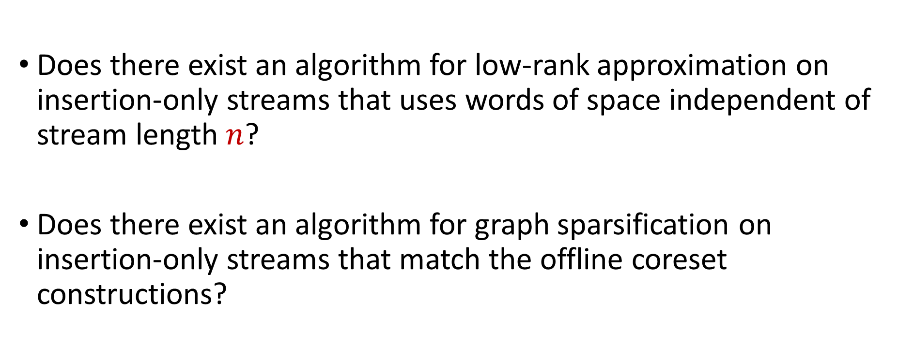
Open Questions
Does there exist an algorithm for low-rank approximation on insertion-only streams that uses words of space independent of stream length $n$?
Does there exist an algorithm for graph sparsification on insertion-only streams that match the offline coreset constructions?

